Slide 1
Helping Employees Outshine the Effects of Pandemic Fatigue
Jamie Notter
speaker | author | consultant
@jamienotter
propelnow.co

Slide 2
#1: Managing Conflict in the Middle of a Pandemic
internal mindset
problem solving
ladder of inference

Slide 3
#2: Shifting Culture for the Hybrid Workplace
what is culture
culture change
5 types of “plays”

Slide 4
acknowledge the impact
make some changes permanent
embrace employee-centric design
#3: Outshining the effects of Pandemic Fatigue

Slide 5
acknowledge the impact
cognitive load
innovative support
long tail of recovery

Slide 6
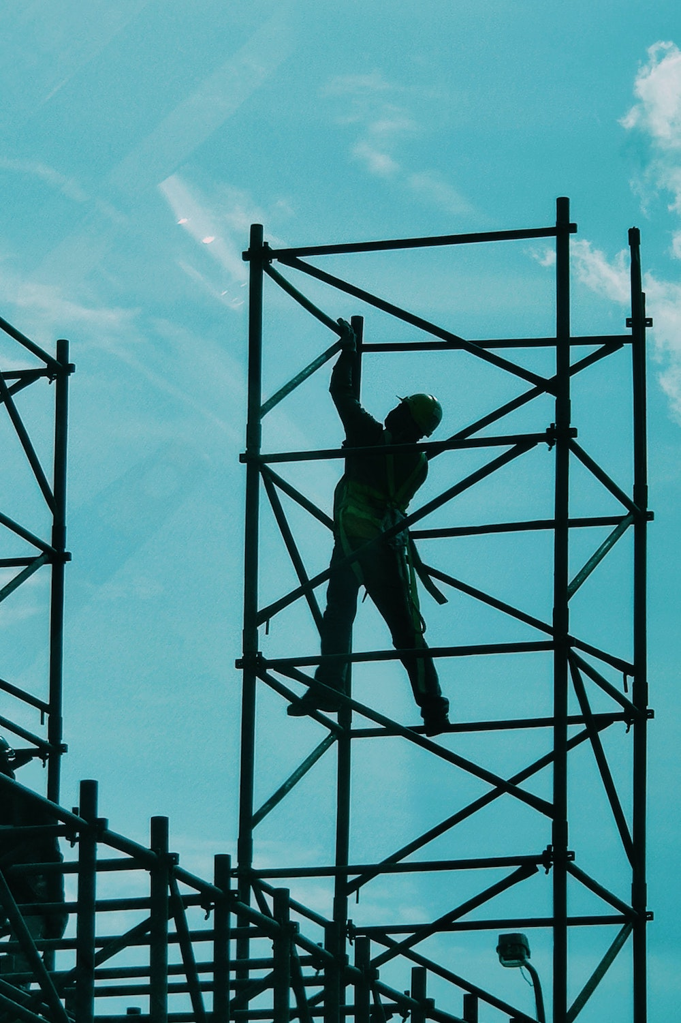
make some changes permanent
practices = systems
hybrid = normal
agility = standard

Slide 7
embrace employee-centric design
customization
flexible managers
future of work

Slide 8
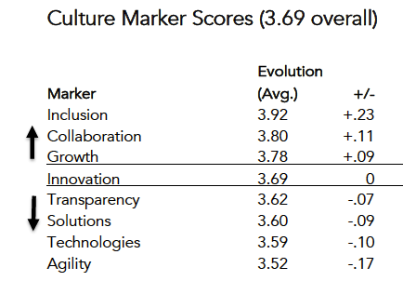

Slide 9
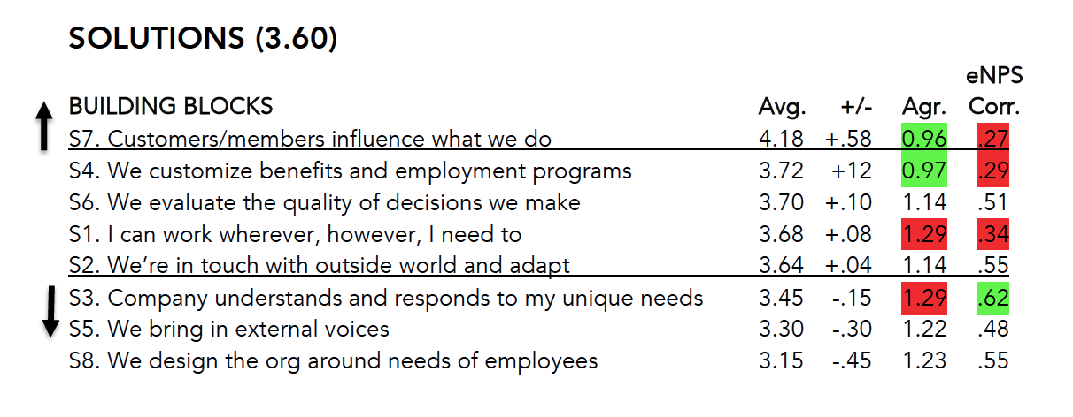

Slide 12
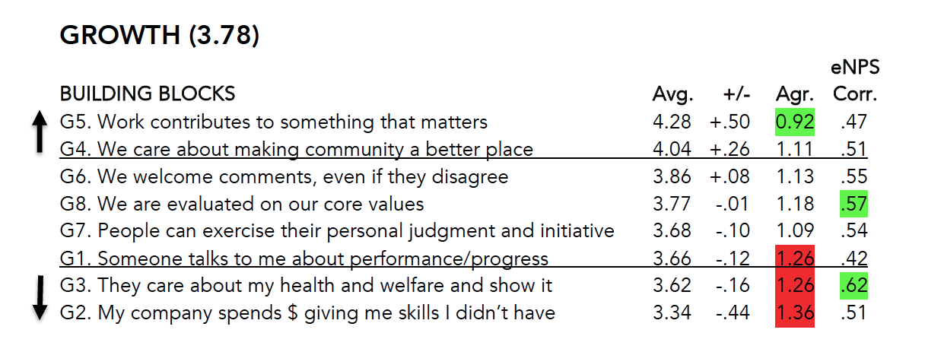

Slide 14
embrace employee-centric design
customization
flexible managers
future of work

Slide 15
acknowledge the impact
make some changes permanent
embrace employee-centric design
#3: Outshining the effects of Pandemic Fatigue

Slide 16
Q&A
Jamie Notter, Co-Founder
jamie@propelnow.co
https://propelnow.co

Slide 17
Image credits
Man on bench: Photo by christopher catbagan on Unsplash
Scaffolding: Photo by Jay Ee on Unsplash
woman on stoop: Photo by Callum T on Unsplash
propelnow.co

