Slide 1
isolved Predictive People Analytics delivered by Commonwealth Payroll & HR
May 23, 2023

Slide 2
Today’s Agenda
Meet Your Presenters
Predictive People Analytics Overview
Solution Demo
Q&A

Slide 3
Our Panel
Jeff Plakans Founder & President, Commonwealth Payroll & HR
Shaun Fowler Account Manager, isolved
Pam Kesler Solution Consultant, isolved

Slide 4
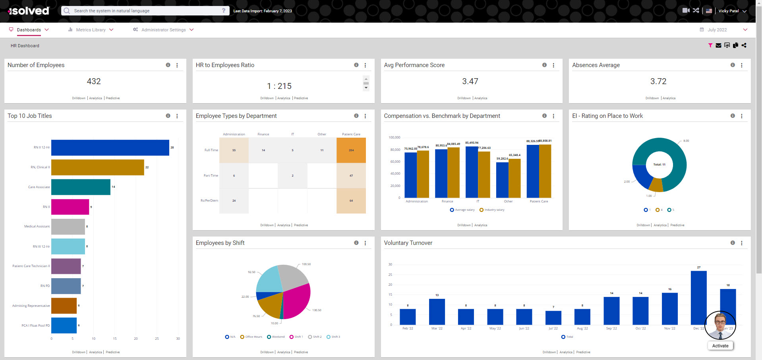
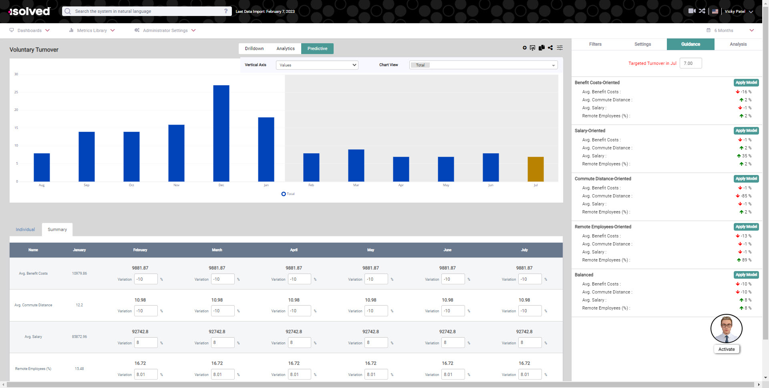
Predictive People Analytics
Powerful & intuitive AI-powered analytic tool
Incorporates and connects key people data sources
Built with a visually rich dashboard-driven design
Includes predictive modeling capabilities for forecasting and what-if analysis

Slide 5
Predictive People Analytics
Key Features
Voice Navigation & Visual Assistant – Enables HR and employees need to simply to “ask for” the information they want to see.
Dashboards – Configurable views of all key people metrics centralized or segmented into user defined groupings that don’t require experts to interpret data.
Historical Trend Analysis – Trend all key metrics over user defined time periods.
Key Events Overlay – Correlate key events over trend analysis to better understand what happened and the effects.
Predictive Modeling – Use trended data to plot scenarios that can help decide what actions are best for the business and the workforce.
NLP (Natural Language Processing) – As applications have become more robust, the complexity in navigating to desired data points and creating the optimum views of that information has also increased.
Predictive Guidance – Set target results and allow Predictive People Analytics to recommend multiple methods to achieve that result.
Enhanced Predictive Analysis – See what factors are affecting future trends and allow you to turn on and off empty factors.

Slide 6
Predictive People Analytics
Benefits
Predictive People Analytics empowers you to firmly establish the links of critical events and evolving corporate metrics, such as productivity and turnover, and ultimately close the loop on how people strategies impact business results.
Identify and address small issues before they have an opportunity to grow into large problems.
See how your company got to where it is, and what needs to be done for a more productive future.
Obtain an overview of trends to understand why they are happening.
Ability to investigate the future and predict optimal ways to reduce turnover and increase profitability

Slide 7
Sample Use Cases
Improve Retention: use the predictive modeling capabilities of PPA to predict potential turnover by identifying who is at risk of leaving and putting together an action plan to reduce the risk.
Increase DEI&B Efforts: easy access to data that can help you identify hiring biases, pay inequities and diverse leadership gaps can help you enhance or stay on track with DEI&B efforts.
Save Time: use the Virtual Assistant equipped with Natural Language Processing (NLP) to request data and have the tool do the work, reducing manual data collection and analysis.

Slide 8
DEMONSTRATION

Slide 9
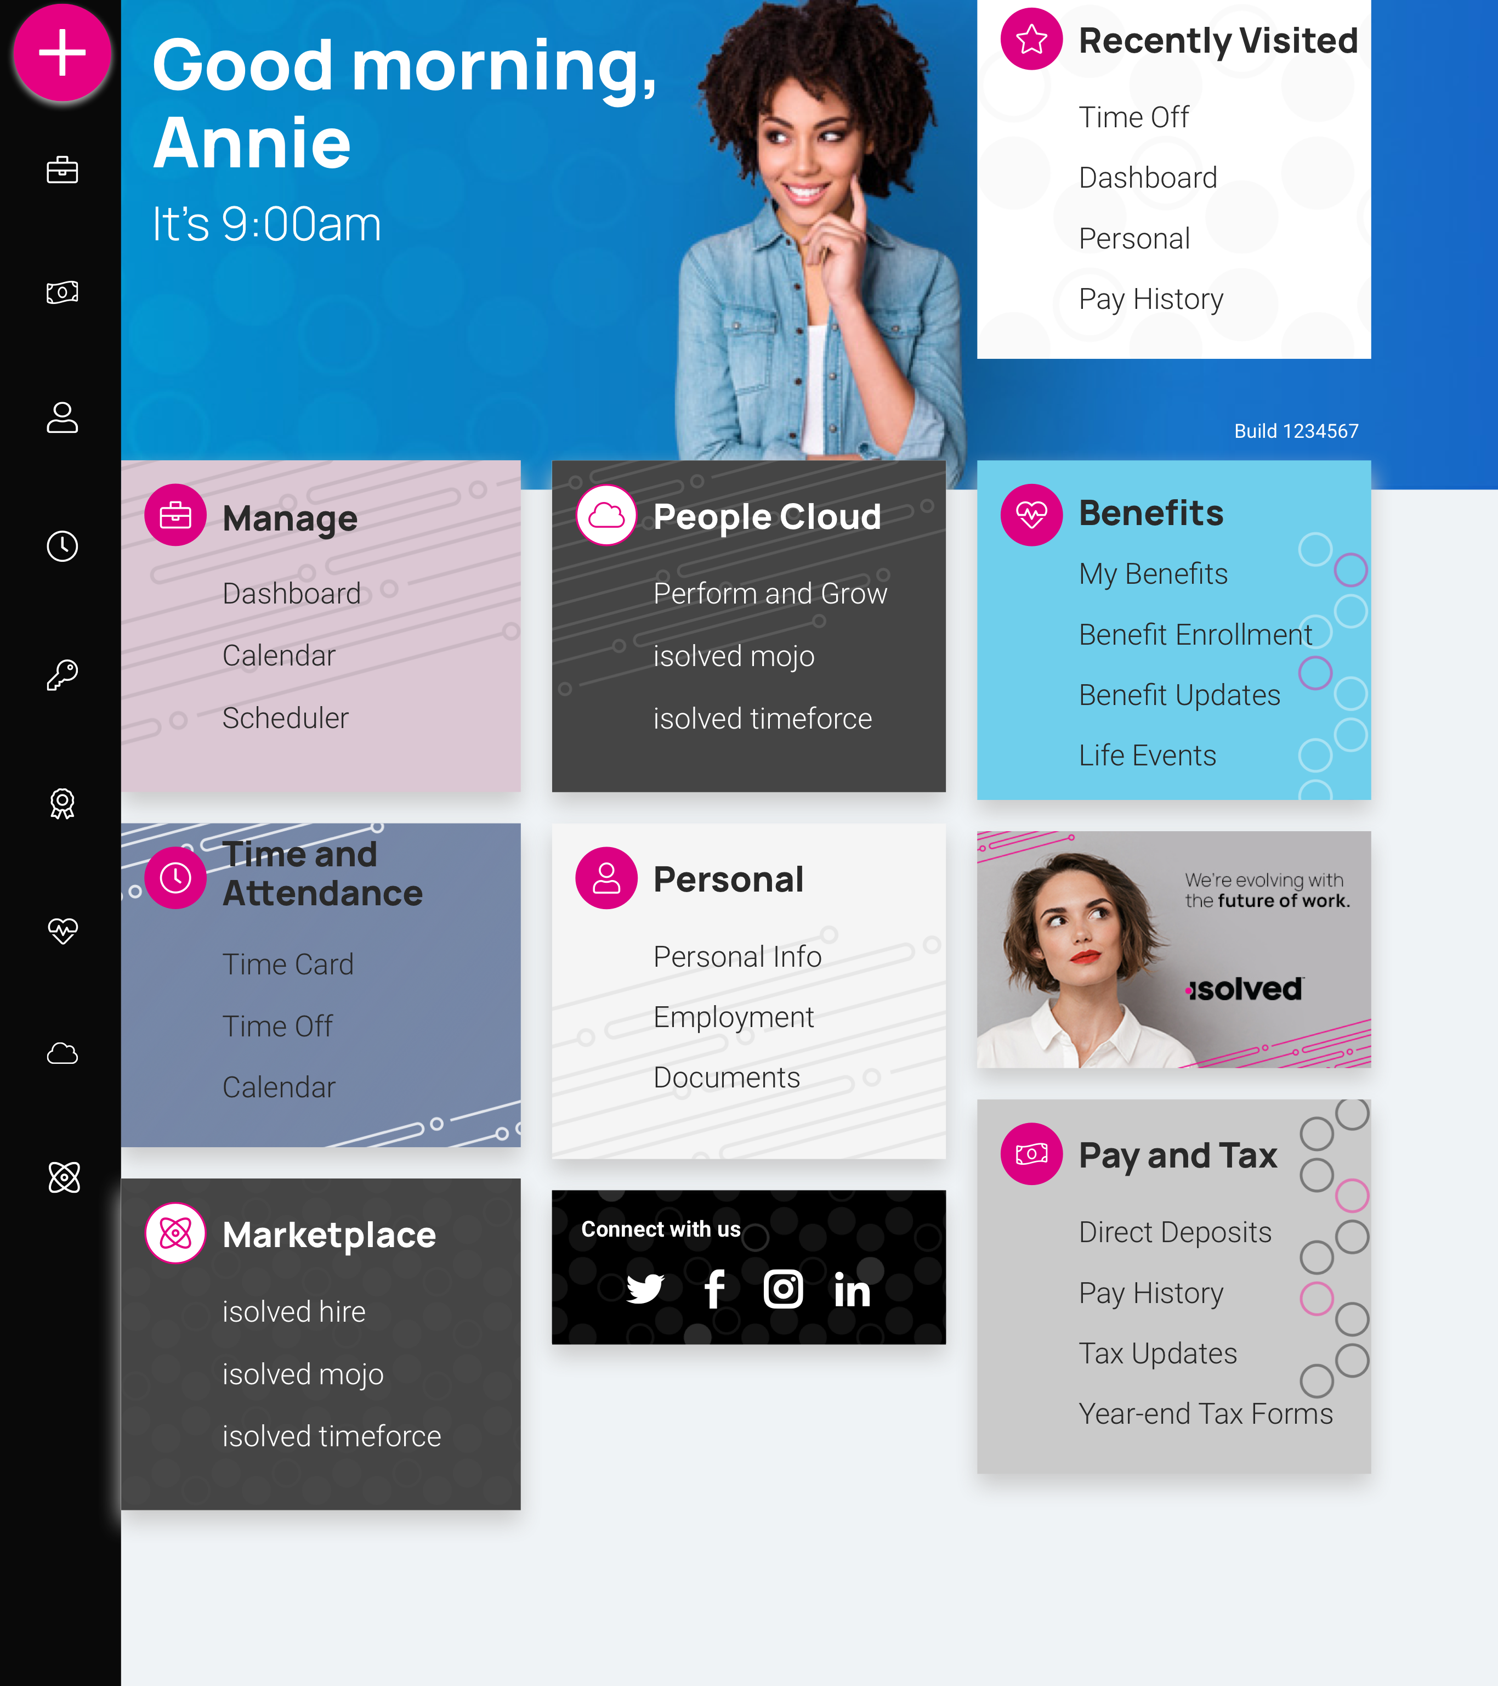
isolved People Cloud
Futureproof, Intelligently Connected HCM
With isolved’s innovative technology, you remain competitive in the marketplace:
Modern, responsive web design
True multi-tenant database
Bi-weekly release cycle
Continuous Product Development
Industry, market & compliance Updates
Competitive updates

Slide 10
Questions?

Slide 11
Thank You!
Whether you have a question or want to learn more, we are happy to speak with you.
978-599-1050
jeff.plakans@commpayhr.com
www.commpayhr.com

