Slide 1
isolved Time & Labor Management delivered by Commonwealth Payroll & HR
July 25, 2023

Slide 2
Today’s Agenda
Meet Your Presenters
Time & Labor Management Overview
Solution Demo
Q&A

Slide 3
Our Panel
Jeff Plakans Founder & President Commonwealth Payroll & HR
Shaun Fowler Account Manager
isolved
Arletta Mills Sr. Solution Consultant isolved

Slide 4
The Situation
Ensuring accurate payroll and effective scheduling, while dealing with the added intricacies of time and labor management, is a challenge.
Employees expect - and need - payroll to be correct, and for tasks like clocking in and out to be simple.
Time inaccuracies can harm the bottom line and tie up resources.
Distributed workforces have created unique challenges to accurately manage time, attendance and scheduling.
Outdated time tracking hardware and software create further complications.

Slide 5
The Solution
isolved Time and Labor Management is a feature-rich solution that enhances time, attendance and scheduling procedures for your entire workforce—even across employees who are remote or on the go.
Reduce inefficiency and errors
Enable flexible time tracking
Ensure end-to-end time visibility
Simplify and improve scheduling

Slide 6
Capturing Time
Key Features
Time Clocks​
Wide array of easy-to-use clocks including:​
Card swipe​
Badge reader​
Biometric ​
Real time integration with isolved Time & Expense​
Web Punch​
Clock in from isolved People Cloud ESS​
One-click Quick Punch or Detailed Punch to track labor values​
Virtual Clocks​
Kiosk-style punching in and out​
Secure and configurable​
Mobile Punch​
Punch in and out using mobile device​
Quick Punch or Detailed Punch​
Geofencing capabilities​

Slide 7
Scheduling Options
Key Features
Attendance​
Create shifts​
Apply default schedules and schedules on the fly​
Access to a calendar view of shifts​
Scheduling​
Establish schedule permission rules​
Determine shift eligibility​
View employee unavailability​
Allow employees to request and swap shifts​
Provide alerts when schedules are available to view​
Workforce Scheduling​
Set EE count per shift values​
Build staffing rules​
Add EEs to shifts with graphical schedule view​
Send notifications to employees​
Predict staffing requirements across employee groups and time periods​

Slide 8
DEMONSTRATION

Slide 9
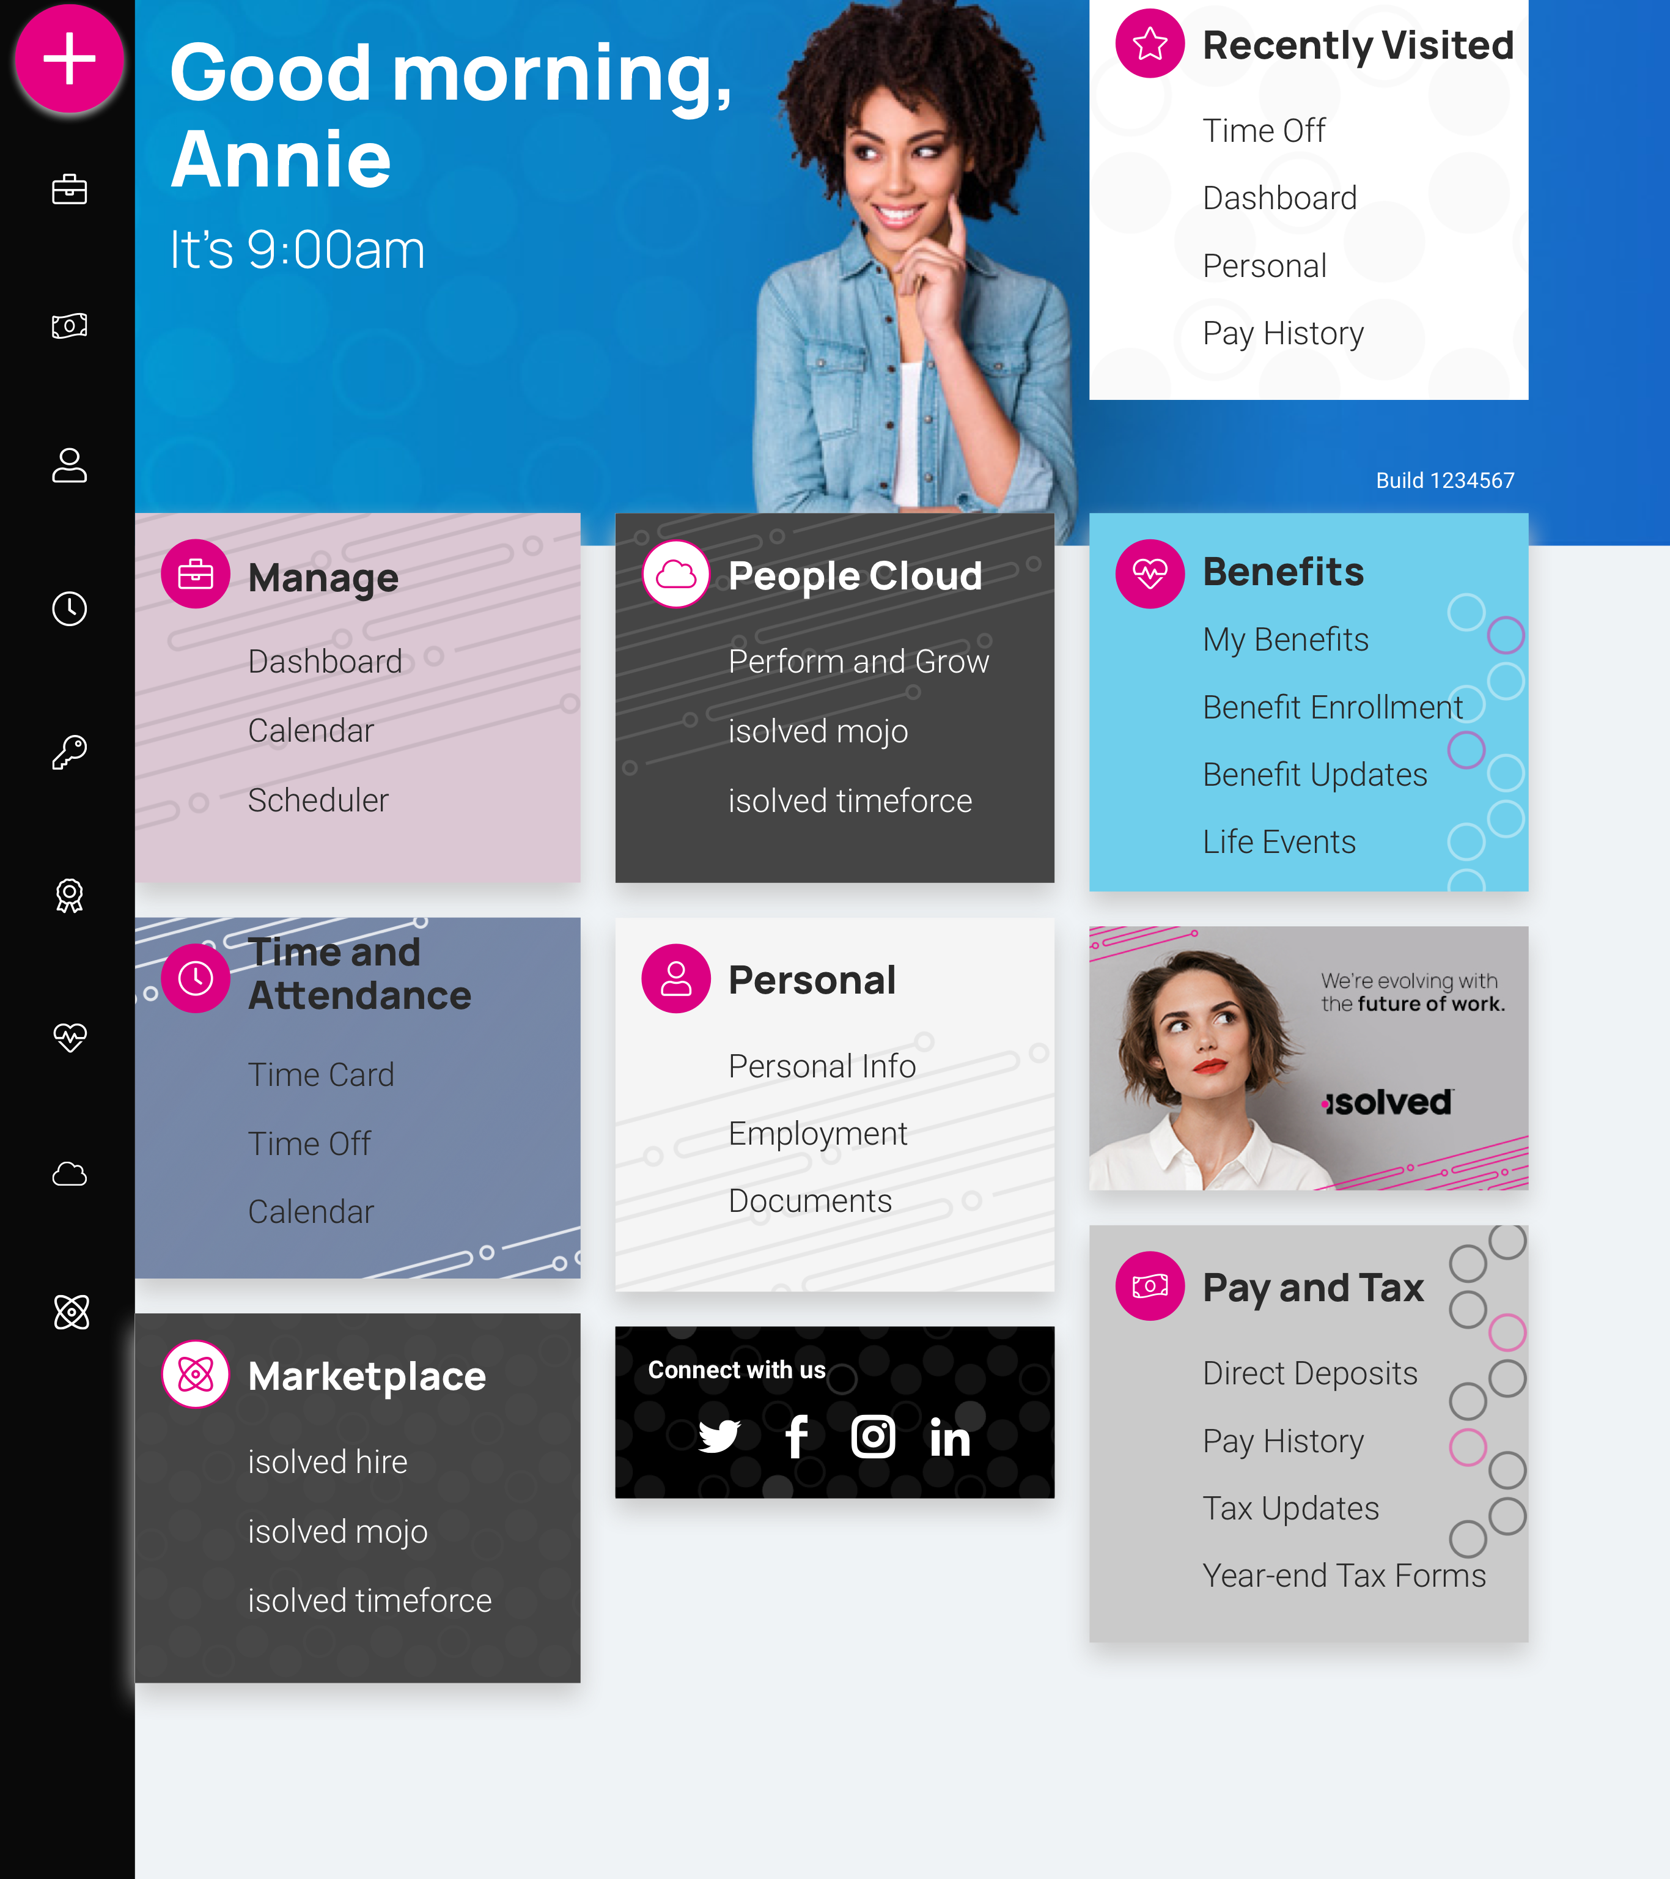
isolved People Cloud
Futureproof, Intelligently Connected HCM
With isolved’s innovative technology, you remain competitive in the marketplace:
Modern, responsive web design
True multi-tenant database
Bi-weekly release cycle
Continuous Product Development
Industry, market & compliance Updates
Competitive updates

Slide 10
Questions?

Slide 11
Thank You!
Whether you have a question or want to learn more, we are happy to speak with you.
978-599-1050
jeff.plakans@commpayhr.com
www.commpayhr.com

