Slide 1
Boost Employee Performance and Engagement with Share & Perform
March 28, 2023

Slide 2
Today’s Agenda
Meet Your Presenters
Share & Perform Overview
Solution Demo
Q&A

Slide 3
Our Panel
Jeff Plakans Founder & President, Commonwealth Payroll & HR
Shaun Fowler Account Manager, isolved
Sean Salins Senior Solution Consultant, isolved

Slide 4
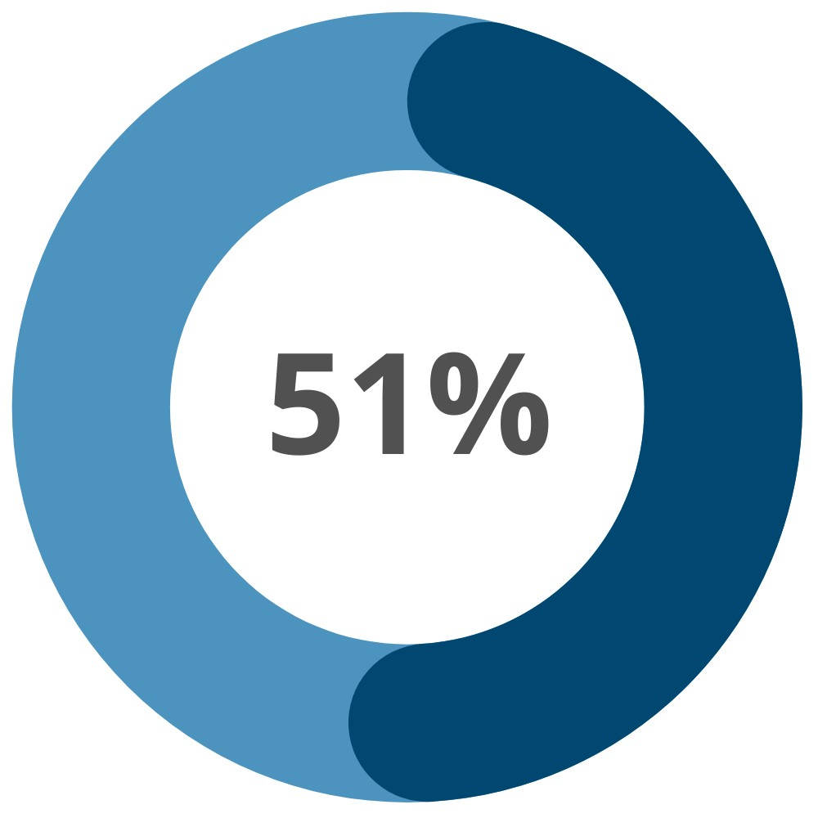
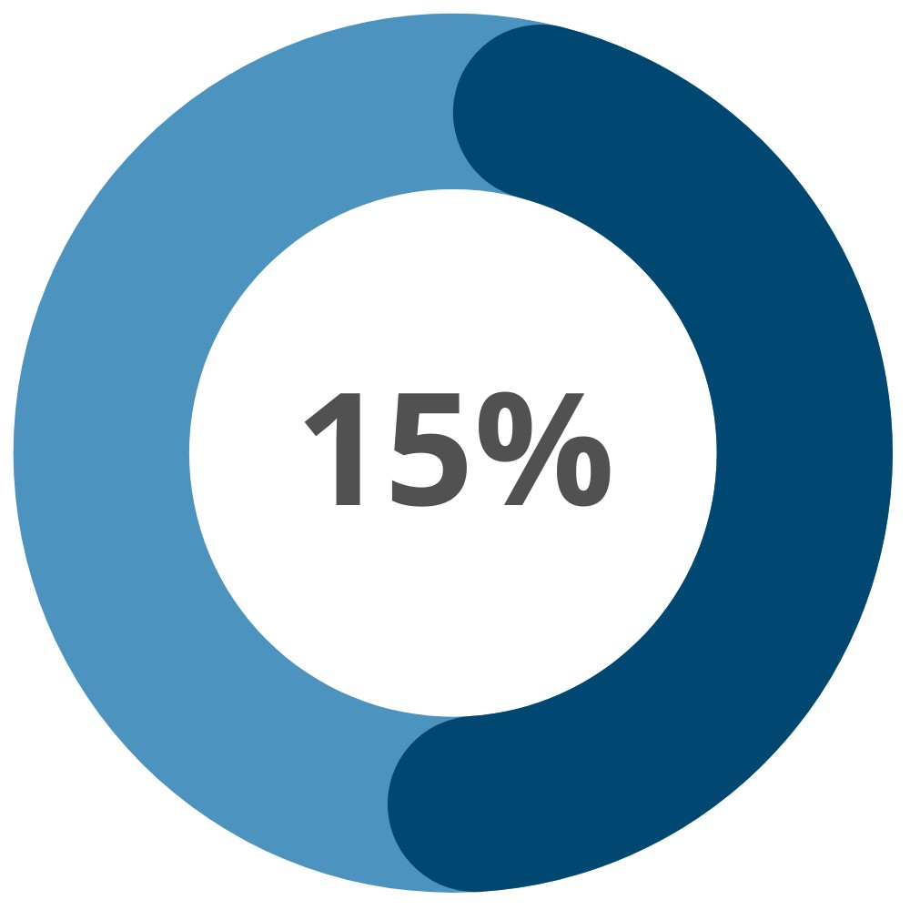
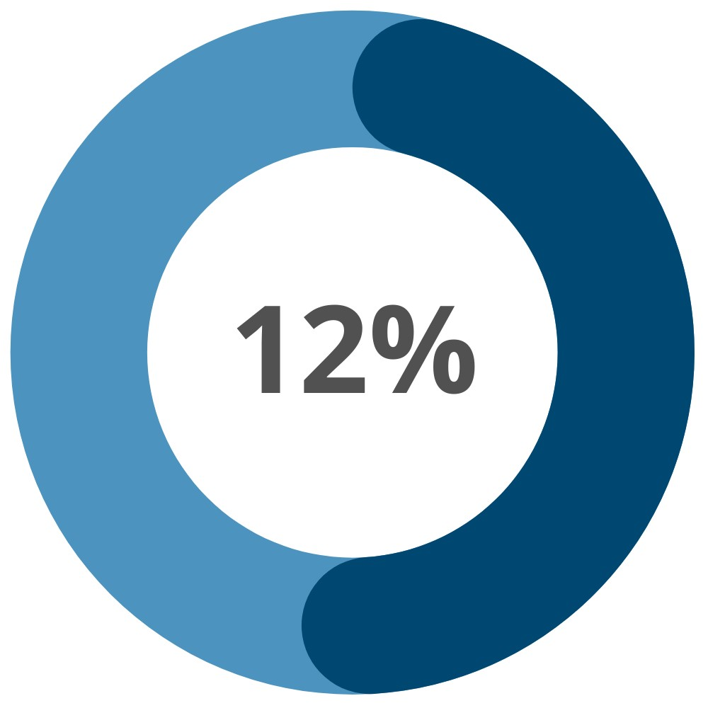
The Situation
The pandemic, widespread burnout, a record number of resignations and an economic downturn have made it an unprecedented time for employers. Businesses of all sizes and in all industries must deliver an exceptional EX if they are going to maintain a thriving workforce, and failure to do so will directly affect their bottom lines.
51% of employees rate their company employee experience (EX) as poor or average
15% of employees say employee engagement (collaboration, feedback) needs the most improvement
12% of employees say performance reviews (goal setting, progress) need the most improvement
^{Isolved 2023 HR Trends Report}

Slide 5
The Solution
Enabling your employees to stay connected, share ideas, seek feedback and collaborate while also recognizing them beyond the context of work delivers a better work life – helping to improve corporate culture, engagement productivity and performance.
With isolved Share & Perform, you can enable multi-directional employee communication and leverage built-in recognition and performance tools that allow both employees and managers to engage in maximum business success.

Slide 6
Share & Perform
Key Features
With Share & Perform, you can get insights into the performance and results of every member of your team while keeping everyone aligned with the goals of the company.
Lively Feed Wall
Personalized Dashboards
Pulse Surveys
Reward & Recognition Tools
Gamification
Interactive Org Charts
Performance Reviews
360 Feedback
Goal-Setting & Monitoring
Nine Box

Slide 7
Share & Perform
Key Benefits
Share & Perform is the solution that addresses a variety of corporate challenges:
Energize company culture
Increase operational efficiency and compliance
Connect virtual teams
Improve employee engagement
Reward and recognize performance
Leverage employee data and insights

Slide 8
DEMONSTRATION

Slide 9
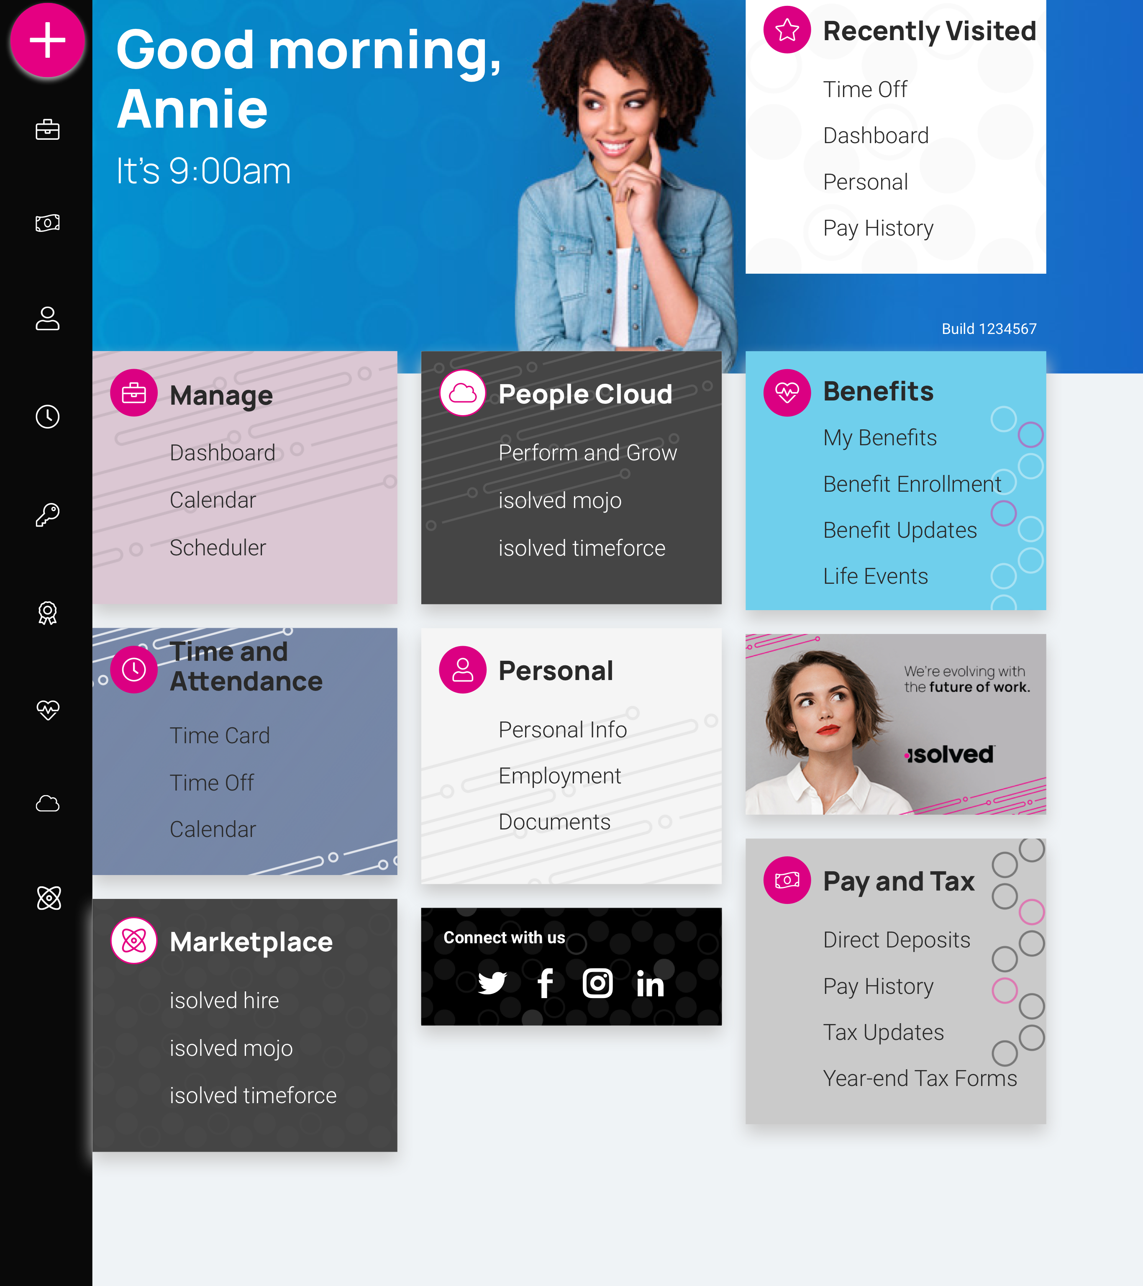
isolved People Cloud
Futureproof, Intelligently Connected HCM
With isolved’s innovative technology, you remain competitive in the marketplace:
Modern, responsive web design
True multi-tenant database
Bi-weekly release cycle
Continuous Product Development
Industry, market & compliance Updates
Competitive updates

Slide 10
Questions?

Slide 11
Thank You!
Whether you have a question or want to learn more, we are happy to speak with you.
978-599-1050
jeff.plakans@commpayhr.com
www.commpayhr.com

