Slide 1
Hire Better People, Faster with isolved Attract & Hire
April 23, 2024
Copyright © 2023. Confidential

Slide 2
Today’s Agenda
Meet Your Presenters
Attract & Hire Overview
Solution Demo
Q&A

Slide 3
Our Panel
Jeff Plakans Founder & President, Commonwealth Payroll & HR
Shaun Fowler Account Manager, isolved
Dave Braby Solution Consultant, isolved

Slide 4
The Situation
There are 3 top major hiring challenges keeping recruiters up at night…
Lack of qualified candidates
Ever-increasing competitive talent landscape
More open roles to fill
SHRM Recruiter Nation Report 2023-2024

Slide 5
92% of HR leaders plan to ramp up their use of automation in at least one area of talent acquisition and people management.
Forbes Business HR and Recruitments Trends for 2024

Slide 6
The Solution
With isolved Attract & Hire, you can seamlessly manage every stage of the recruiting process from attracting candidates to screening, interviewing, selecting, and ultimately hiring.
You can streamline hiring by...
Leveraging tools that source active and passive candidates into talent pools
Automating manual tasks
Making informed hiring decisions using key metrics to better understand hiring needs and candidate fit

Slide 7
Attract & Hire
Features & Benefits
CAPABILITIES
BENEFITS
Whether you want to scale your team quickly, source remote candidates, or reach diverse talent, isolved Attract & Hire enables you to quickly locate, interview and onboard the best-fit candidates for your organizational needs.
Branded career pages to boost employer brand
Over 5,000 free & paid job boards​
Job Ad Writer AI Tool
Candidate Match AI recruiting tool
Configurable & mobile-friendly applications
Calendar integration and interview scheduling links
Candidate scoring and spotlight
Candidate profiles in-depth reporting
Unlimited users and positions
Make smarter hiring decisions using actionable insights
Provide a better candidate experience
Reduce time and cost-to-hire
Stay top of mind with candidates
Hire at scale
Seamless integration with isolved Onboard & Develop

Slide 8
DEMONSTRATION

Slide 9
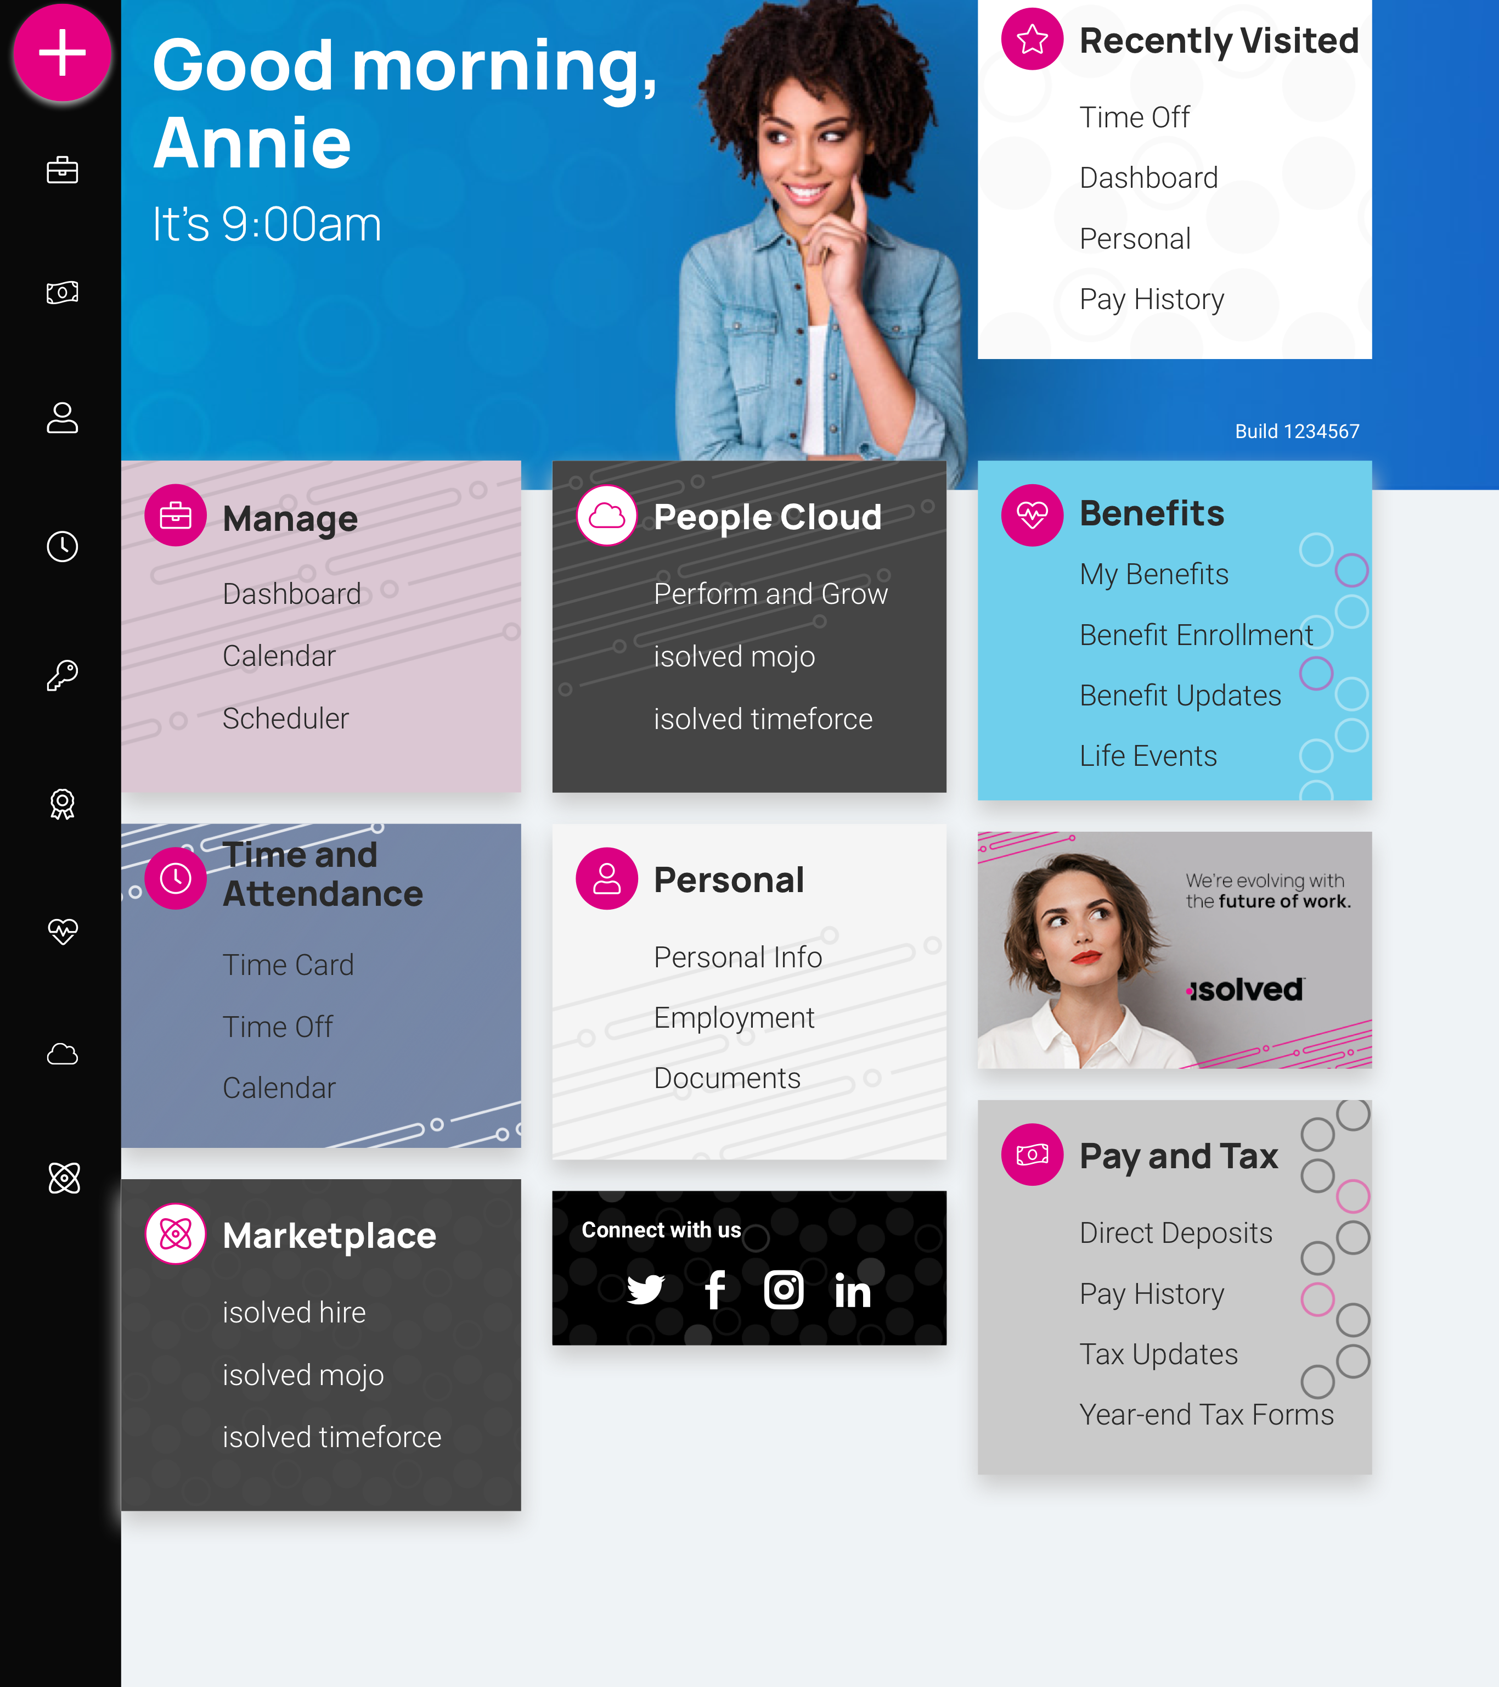
isolved People Cloud
Futureproof, Intelligently Connected HCM
With isolved’s innovative technology, you remain competitive in the marketplace:
Modern, responsive web design
True multi-tenant database
Bi-weekly release cycle
Continuous Product Development
Industry, market & compliance Updates
Competitive updates

Slide 10
Questions?

Slide 11
Thank You!
Whether you have a question or want to learn more, we are happy to speak with you.
978-599-1050
jeff.plakans@commpayhr.com
www.commpayhr.com

