Slide 1
isolved Learn & Grow | Accelerate Employee Development
March 26, 2024
Copyright © 2023. Confidential

Slide 2
Today’s Agenda
Meet Your Presenters
Learn & Grow Overview
Solution Demo
Q&A

Slide 3
Our Panel
Jeff Plakans Founder & President, Commonwealth Payroll & HR
Shaun Fowler Account Manager, isolved
Dave Braby Solution Consultant, isolved

Slide 4
The Situation
Employee learning continues to be a growing benefit as skilled credentials are increasingly valued—from training and course completion certificates to industry or professional certifications.
68% of respondents say they would be more likely to stay with their current employer if more upskilling opportunities were provided
67% of employees say learning and development is an important interest to them, ranking it top 5 in major employee benefits categories
67%
^{SHRM Benefits Report 2023}

Slide 5
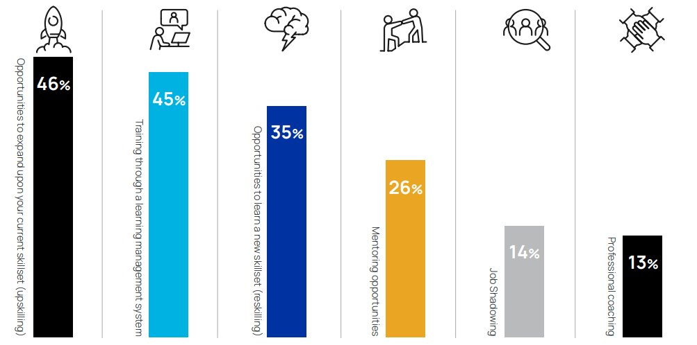
The Situation
When asked what type of support their employer provided for their career growth and professional development, employees said:
Isolved HR Trends Report 2023: Pause, Pivot or Plan hends-of-2023-pause-pivot-or-plan

Slide 6
Organizations that invest in employee experience have more than 4x the profit and 2x the revenue. And employees that experience higher engagement levels outperform their peers 147% in EPS.¹
¹ Harvard Business Review: Design Your Employee Experience as Thoughtfully as You Design Your Customer Experience

Slide 7
The Solution
Streamline employee learning to boost productivity and engagement with isolved Learn & Grow
isolved Learn & Grow makes learning more accessible to everyone on your team. Bring together learning in one LMS platform that is part of your HCM solution — delivered anytime, anywhere.

Slide 8
Learn & Grow
Features & Benefits
CAPABILITIES
BENEFITS
Source, create and deliver educational content and training programs to your employees wherever they work.
Comprehensive dashboards and reporting​
Personalized and configurable curriculum​
SCORM compliant courses​
Social learning tools and gamification elements​
Training recommendations to enhance employee learning experience​
Robust and inclusive Content Library
Gain productivity: encourage employees to grow personally & professionally​
Improve retention: keep employees engaged and happy with continuous learning opportunities​
Ensure compliance: transform the way your employees learn while meeting regulatory requirements​
Increase engagement: reward and recognize employees with digital merit badges and certifications

Slide 9
DEMONSTRATION

Slide 10
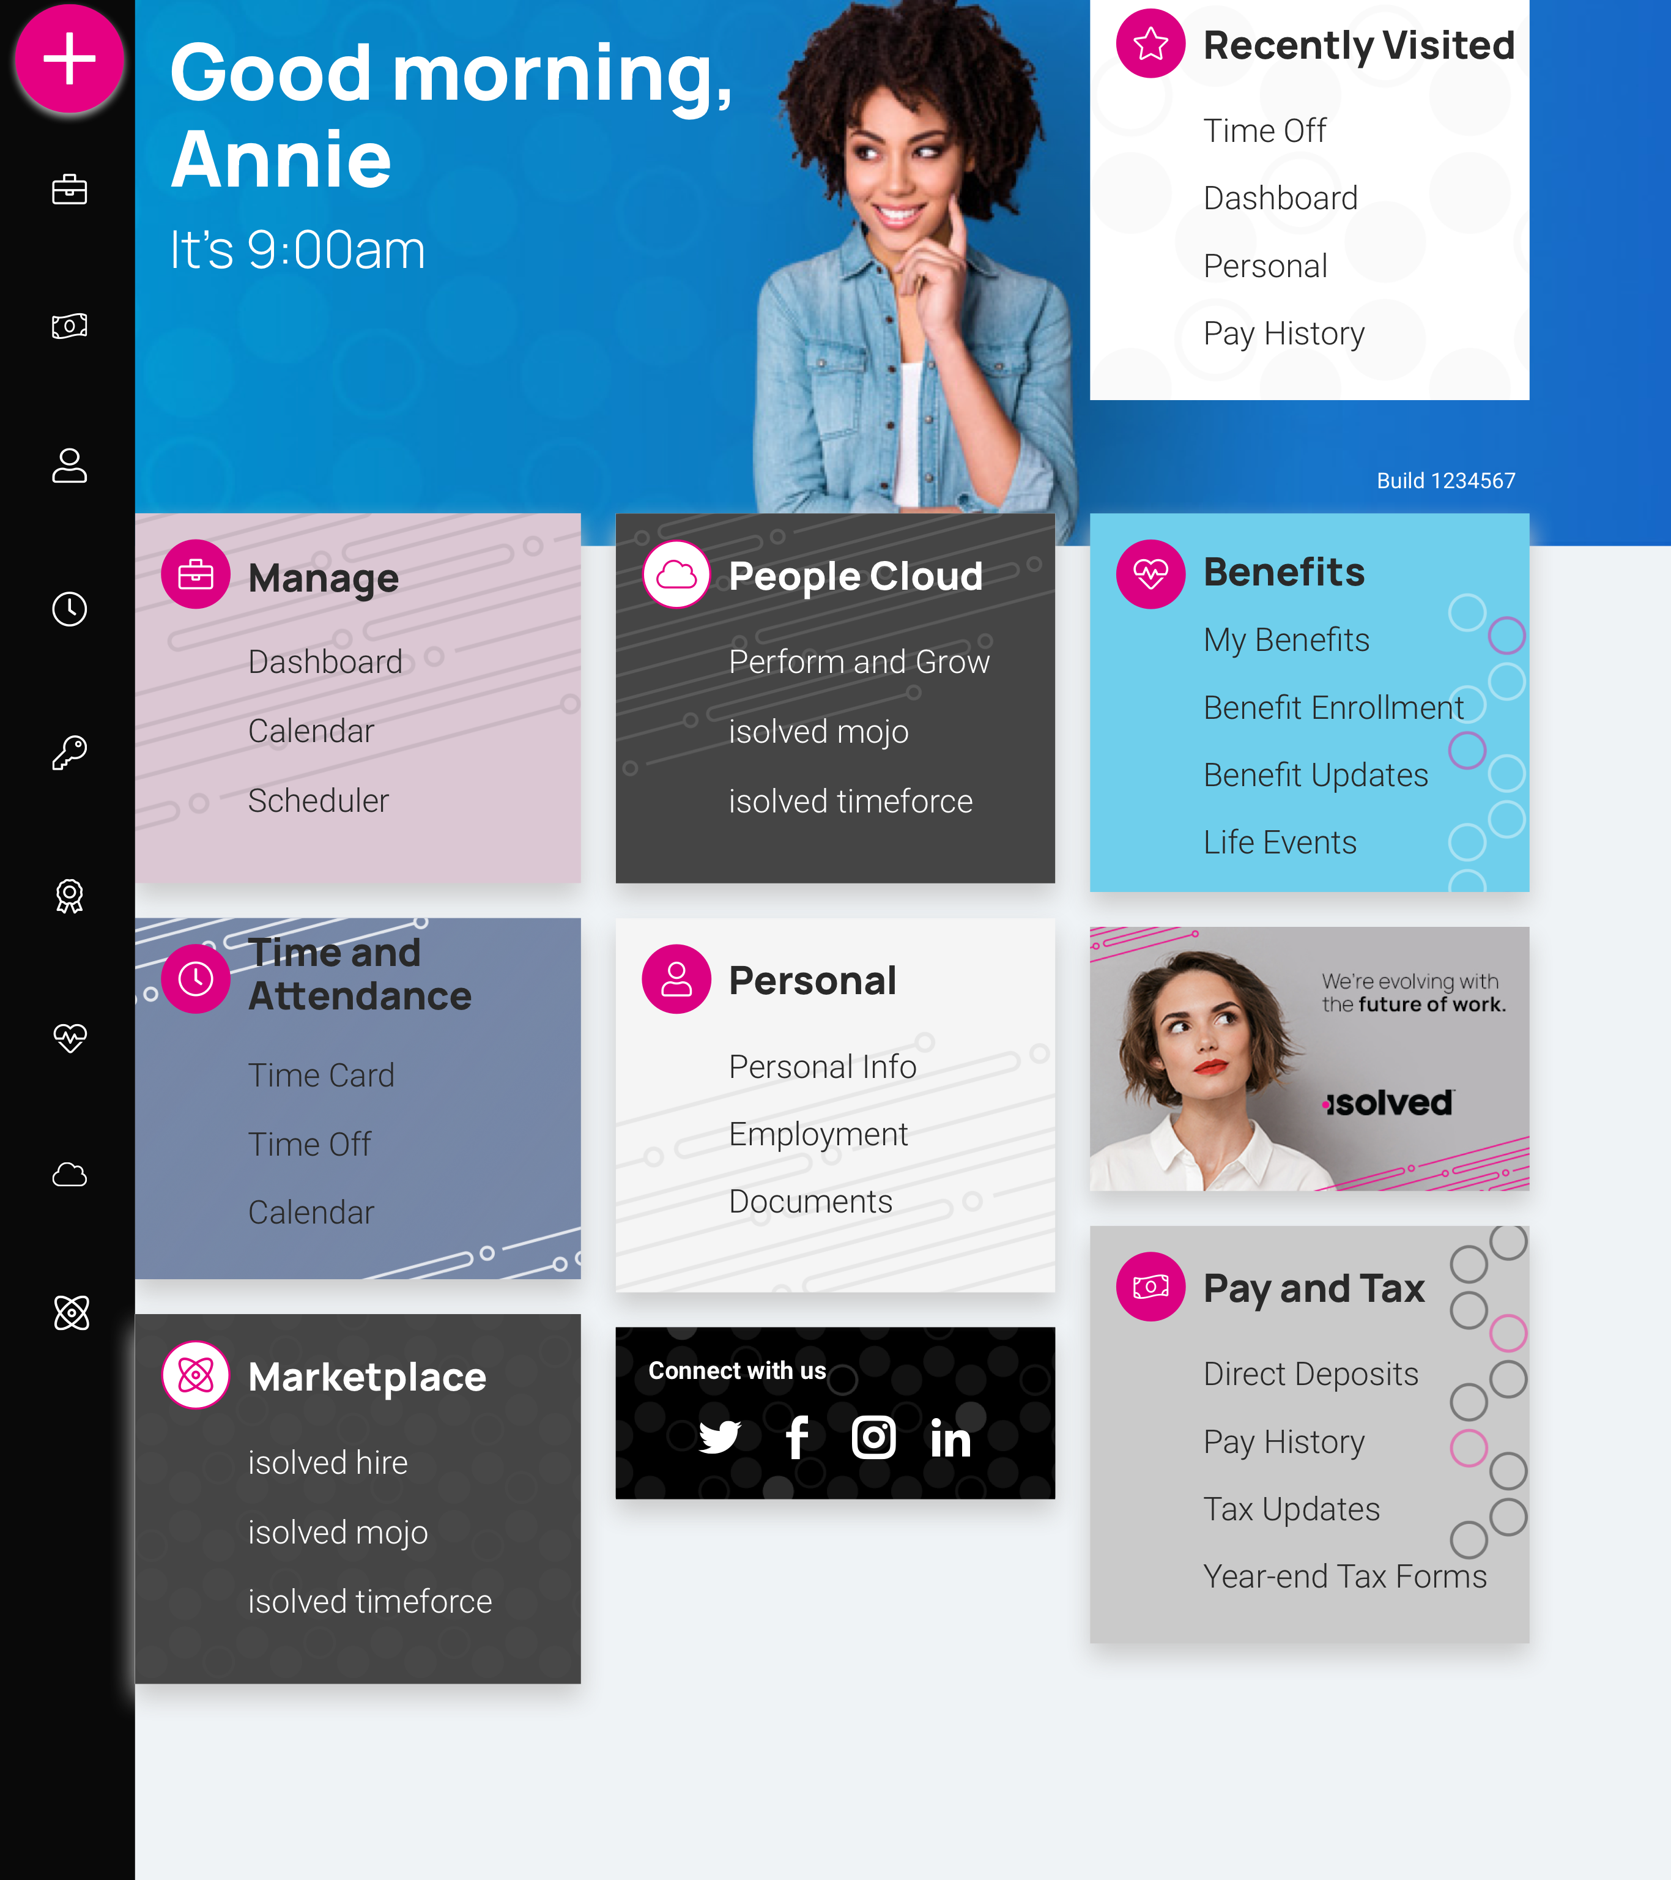
isolved People Cloud
Futureproof, Intelligently Connected HCM
With isolved’s innovative technology, you remain competitive in the marketplace:
Modern, responsive web design
True multi-tenant database
Bi-weekly release cycle
Continuous Product Development
Industry, market & compliance Updates
Competitive updates

Slide 11
Questions?

Slide 12
Thank You!
Whether you have a question or want to learn more, we are happy to speak with you.
978-599-1050
jeff.plakans@commpayhr.com
www.commpayhr.com

