Slide 1
Reduce Your Administrative Burden with Expense Management
June 5, 2024
Copyright © 2023. Confidential

Slide 2
Today’s Agenda
Meet Your Presenters
Expense Management: Key Features & Benefits
Demo
Q&A

Slide 3
Our Panel
Jeff Plakans Founder & President, Commonwealth Payroll & HR
Shaun Fowler Account Manager, isolved
David Braby Solution Consultant, isolved

Slide 4
Expense Management
Configurable Approval Workflow
Consolidate Expenses for Payment
Customizable Expense Types
Entry Shortcuts - Trip and Guest
Multi-Country/Currency Support
Receipt Images and Attachments
Analysis Dashboards and Reports
Key Features

Slide 5
Expense Management
Key Benefits
Reimburse employees faster and with minimal friction
Increase productivity, reduce overhead cost and boost employee satisfaction
Maintain accurate financial records and planning
Reduce errors and enhance fraud prevention
Improve and maintain compliance with your expense policy
Enable employees to upload receipts and track expenses from anywhere with Adaptive Employee Experience

Slide 6
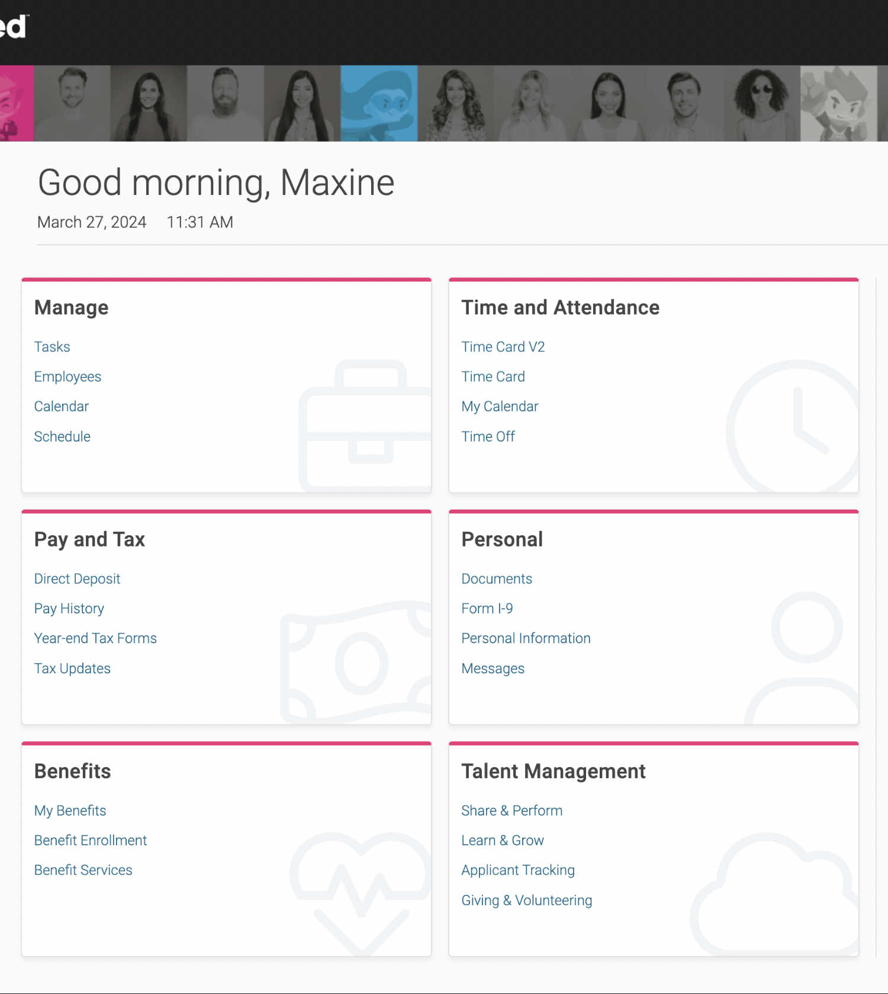
isolved People Cloud
Futureproof, Intelligently Connected HCM
With isolved’s innovative technology, you remain competitive in the marketplace:
Modern, responsive web design
True multi-tenant database
Bi-weekly release cycle
Continuous Product Development
Industry, market & compliance Updates
Competitive updates

Slide 7
Questions?

Slide 8
Thank You!
Whether you have a question or want to learn more, we are happy to speak with you.
978-599-1050
jeff.plakans@commpayhr.com
www.commpayhr.com

